Slide 1
Title Slide
Title: LLM-Powered Chatbot for Step Up Dance Academy Subtitle: Automating Customer Interactions with AI REET KAUR | ML Engineer Take-Home Assessment

Slide 2
Problem Statement
Current Challenges:
Manual helpdesk responses are time-consuming and inconsistent.
Lack of 24/7 availability for customer inquiries.
Inefficient management of student queries and event information.
Need for Automation:
Improve response efficiency and accuracy.
Reduce workload on staff.
Enhance user experience with instant query resolution.

Slide 3
Goal Statement
Objective: Develop an LLM-powered chatbot to automate customer interactions, provide accurate information, and improve accessibility.
Expected Benefits:
Faster and more reliable responses.
Reduced staff dependency for routine queries.
Seamless user engagement and promotion of services.

Slide 4
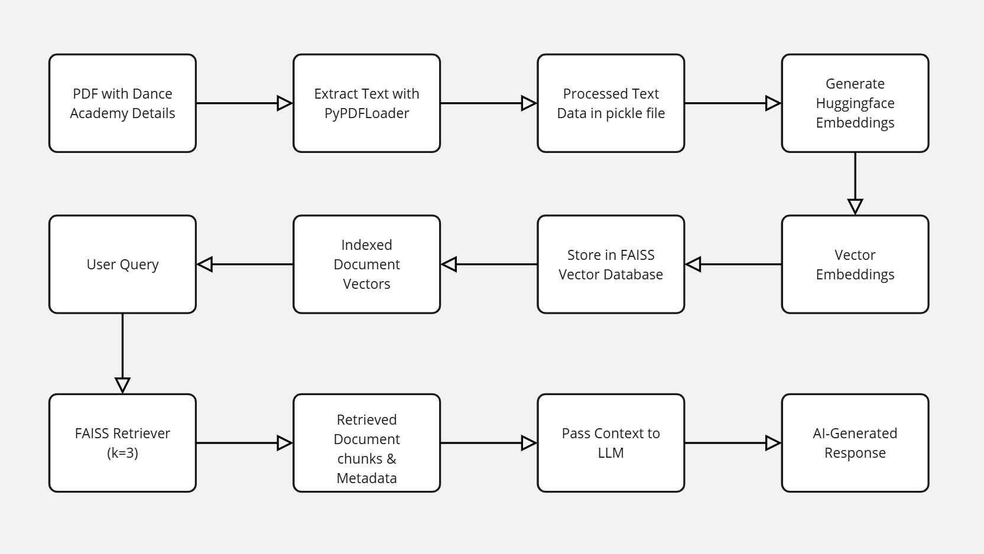
Workflow Overview

Slide 5
A short flowchart illustrating key steps:-
Data Collection: PDF extraction (academy details, dance forms, fees, events, etc.)
Data Processing: Text extraction, embedding generation.
Storage: FAISS vector database for efficient retrieval.
Retrieval: Query-based document retrieval from FAISS.
Response Generation (Pending): LLM processing for final response.

Slide 6
Steps Completed
Data Preparation & Extraction
Extracted information from the Step Up Academy PDF using PyPDFLoader.
Saved extracted content in a structured format (pickle file).
Embedding Creation
Used Huggingface embeddings to encode text data.
Vector Database Storage
Stored embeddings using FAISS for efficient similarity search.
Retriever Implementation
Created FAISS retriever (k=3) to fetch relevant documents based on user queries.
Successfully tested retrieval with sample queries.

Slide 7
Pending Steps (Due to Computation Limitations)
LLM Ingestion & Response Generation
The retrieved context needs to be passed to an LLM (LLaMA, Mistral, or Gemini 1.5) for response generation.
Requires higher computation power than currently available.
LLM Evaluation
Compare chatbot responses with and without document retrieval to assess performance improvement.
Define evaluation metrics (e.g., accuracy, response relevance, latency).

Slide 8
Key Learnings & Challenges
Learnings:
Efficient document retrieval using FAISS improves chatbot accuracy.
Open-source tools like PyPDFLoader, FAISS, and Huggingface embeddings provide scalable solutions.
Challenges Faced:
Limited computation resources restricted full LLM implementation.
Need for cloud-based deployment to handle large-scale inference.

Slide 9
Next Steps & Future Improvements
Future Enhancements
Deploy chatbot with cloud-based LLM inference (e.g., Hugging Face Inference API, OpenAI, or Gemini).
Implement LLM fine-tuning for domain-specific accuracy.
Add a frontend UI for real-world interaction.

Slide 10
Conclusion & Final Thoughts
Progress Achieved:
Successfully built RAG-based retrieval for Step Up Dance Academy.
Demonstrated ability to extract, embed, and retrieve relevant knowledge.
Future Scope:
Extend chatbot capabilities with full LLM integration.
Optimize deployment for real-world use.

Slide 11
THANK YOU PRESENTED BY-REET KAUR
GitHub Repository Link: https://github.com/reetdhillon02/Gen-AI-Virtual-Agent/tree/main

